Slide 1
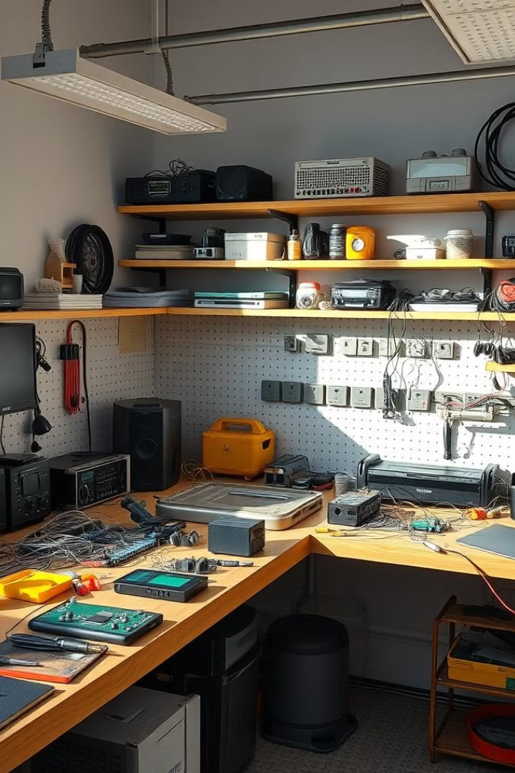
Smart Energy Harvesting
Smart energy harvesting is an innovative approach that utilizes piezoelectric sensors to convert ambient mechanical energy into usable electrical power. This technology holds vast potential for a wide range of applications, from wearable electronics to remote sensor networks.
DP
by Datt Panchal

Slide 2
Introduction to Smart Energy Harvesting
Piezoelectricity
Sensor Applications
Energy Harvesting
The piezoelectric effect is the ability of certain materials to generate an electric charge in response to applied mechanical stress.
Piezoelectric sensors can be used to measure various physical quantities, such as pressure, acceleration, and vibration.
By leveraging the piezoelectric effect, these sensors can be used to capture ambient mechanical energy and convert it into electricity.

Slide 3

Project Objectives
1
Explore Piezoelectric Sensors
2
Design and Implement
Investigate the principles and applications of piezoelectric sensors in energy harvesting systems.
Develop a prototype that demonstrates the effective conversion of mechanical energy into electrical power.
3
Efficiency and Optimization
Analyze the performance and efficiency of the system, and explore potential improvements.

Slide 4
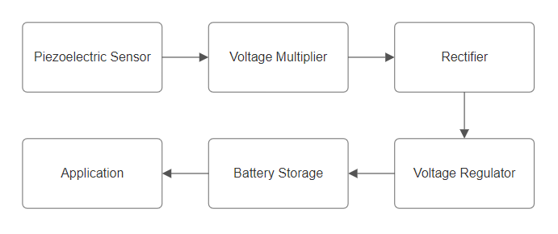
Block Diagram
1
Mechanical Input
Ambient mechanical energy, such as vibrations or pressure, is captured by the piezoelectric sensor.
2
Electrical Generation
The piezoelectric sensor converts the mechanical energy into electrical energy.
3
Power Conditioning
The generated electrical energy is conditioned and stored for later use or direct application.

Slide 5
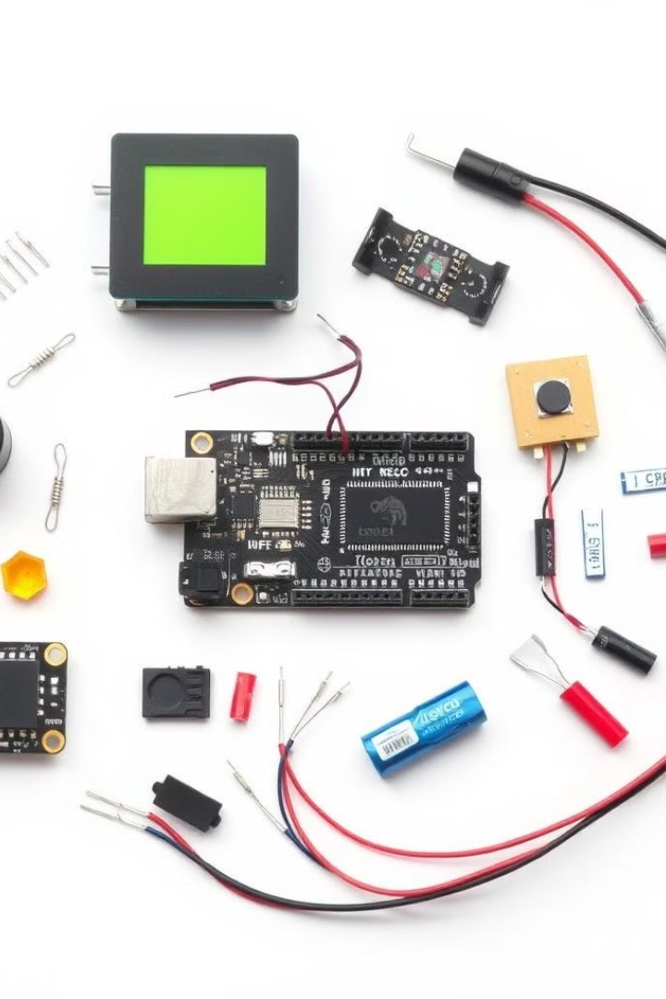
List of Components
Piezoelectric Sensor
Voltage Multiplier Circuit Components
Converts mechanical energy into electrical energy.
Including Diodes, and Capacitors only.
Rectifier Circuit
Additional Components
Including Diode.
Resistors, Multimeter, and interconnecting wires.

Slide 6
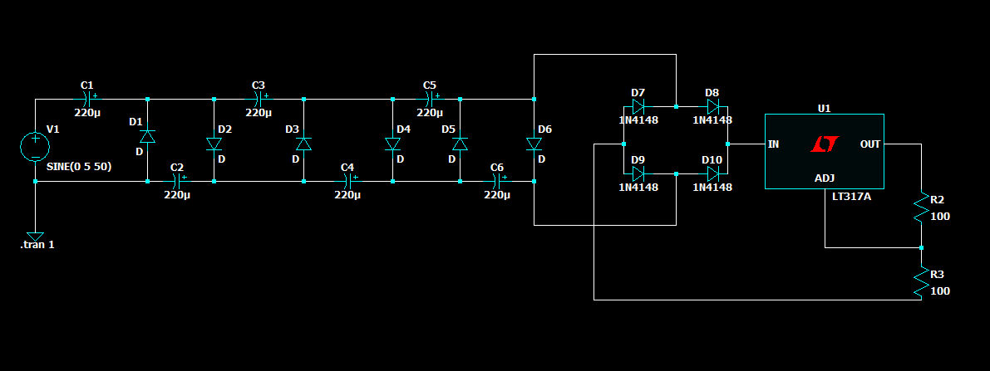
Circuit Diagram

Slide 7
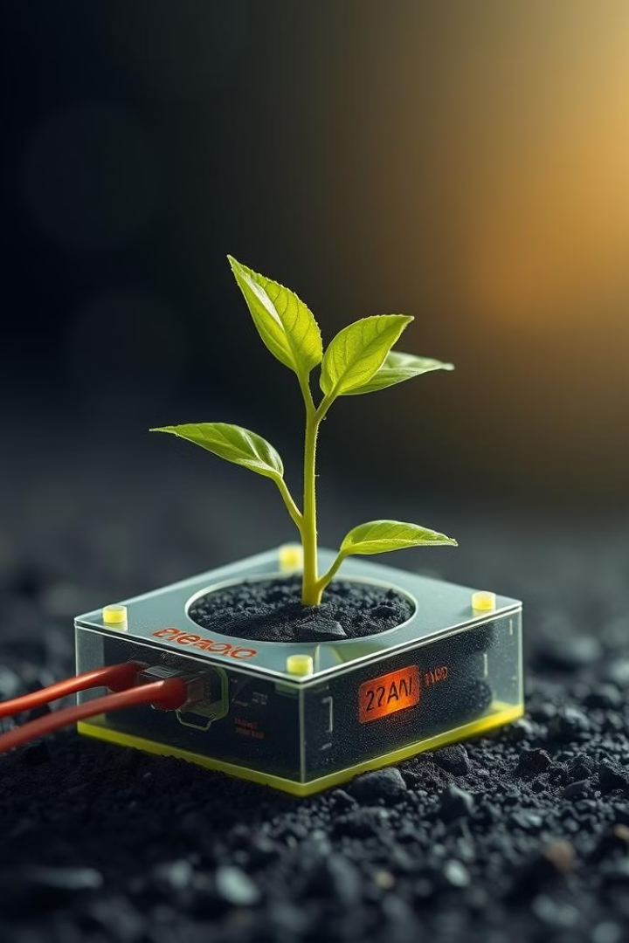



Conclusion and Future Scope
Promising Technology
Piezoelectric energy harvesting has shown great potential in providing sustainable power solutions.
Improved Efficiency
Ongoing research and development can further enhance the efficiency and performance of the system.
Diverse Applications
This technology can be applied to a wide range of fields, from wearables to remote sensor networks.

Slide 8
Thank you.

